Slide 1
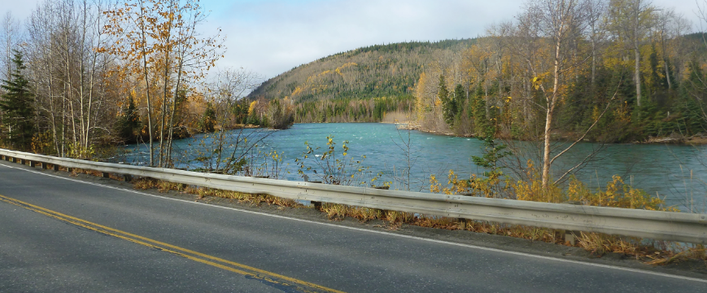
Sterling Hwy MP 45-60
A Cooper Landing Case Study
11/18/2021

Slide 2
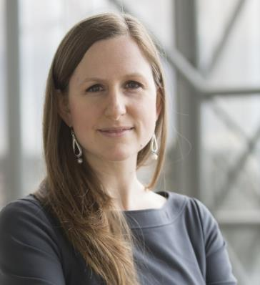
Hello, I’m Katherine Wood
Notes:
Engaged in this project for 20 years
Part of why I came to HDR
Deputy PM and PI lead for end of the EIS
PI lead continuing through present day
NEPA training
IAP2 trained
Note that Julie Jessen and Robyn Reich prob worked on this project!

Slide 3
01 | History
02 | Environmental Phase
03 | Design/Construction Phase
04 | Takeaways

Slide 4
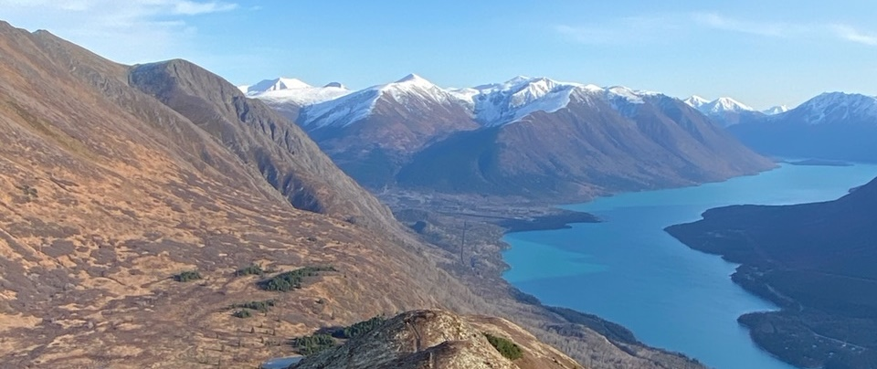
History
Notes:
A little context please

Slide 5
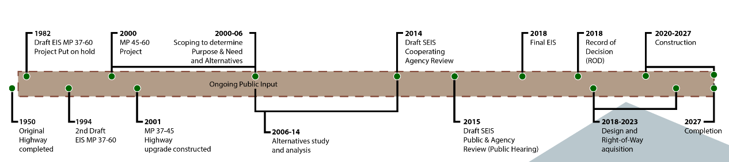
Schedule
Notes:
Overall project schedule – from website b/c this is a story we tell over and over
NOT TO SCALE
Came to Alaska in 2001
Joined HDR in 2007
I became a fly fisherwoman in about 2015…

Slide 6
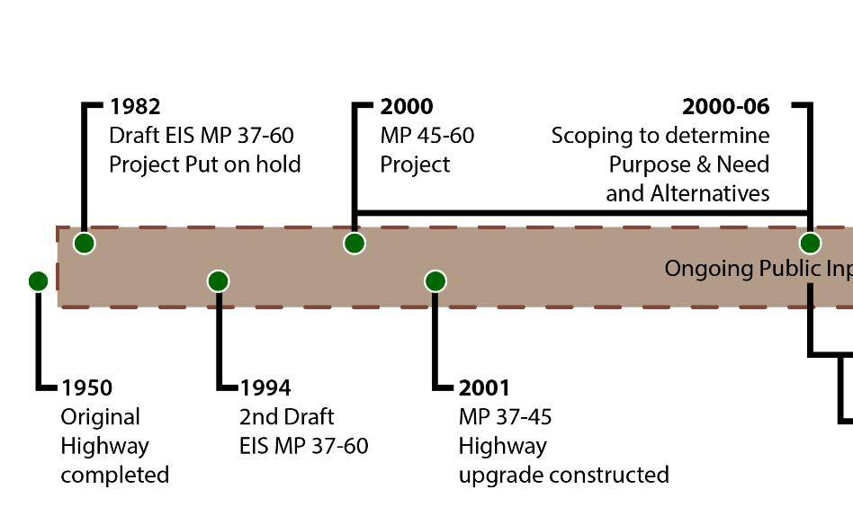
Notes:
Highway built in 1950
Last piece that hasn’t been improved since original construction
Think about cars/trips/population/use
Stop & start on the EIS;
Original 1982 study – done on a type writer – no graphics, etc.
1994 word processing
Split out project section from MP 37-45 and progressed it, as that is “simpler” area to complete
1994 – still can’t come to agreement on the best solution
WHY not? Too many negative impacts.

Slide 7
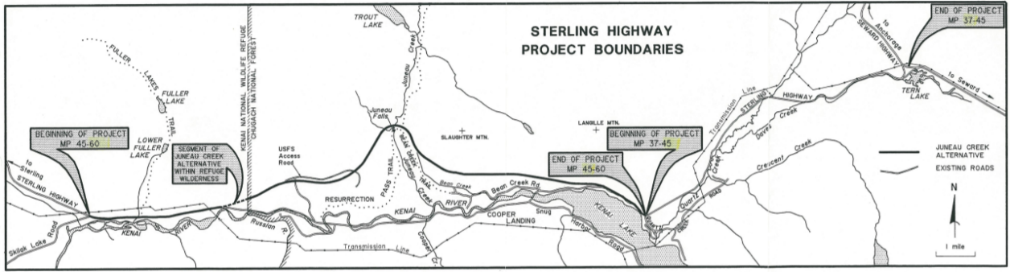

Slide 8
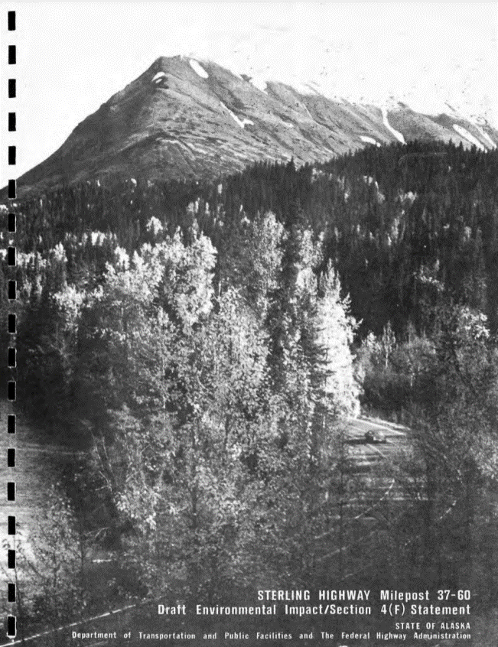
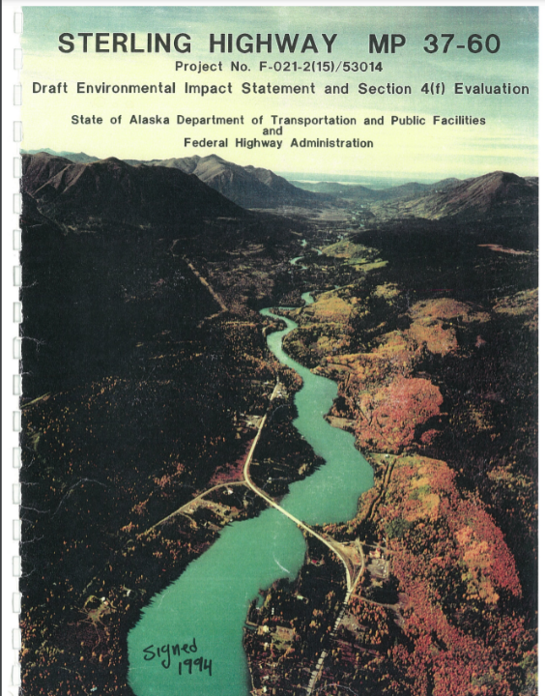
1982
1994

Slide 9
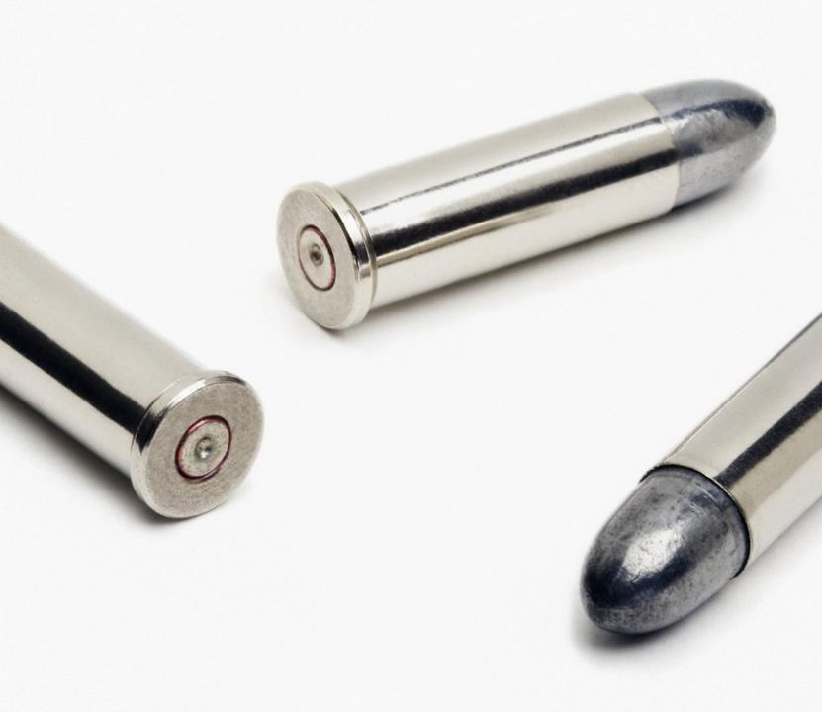
No silver bullet
Thread the needle
Complexity of resources and regulations
Notes:
Why no solution?

Slide 10
Enter the EIS

Slide 11
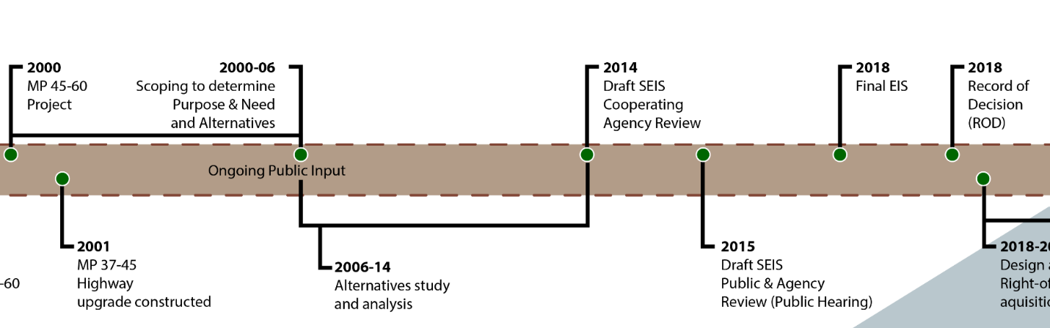
Notes:
2000 – HDR enters the scene to begin the EIS discussions
Scoping intensely from 2000-2003; LOTS of engagement
Tell the frisbee story

Slide 12
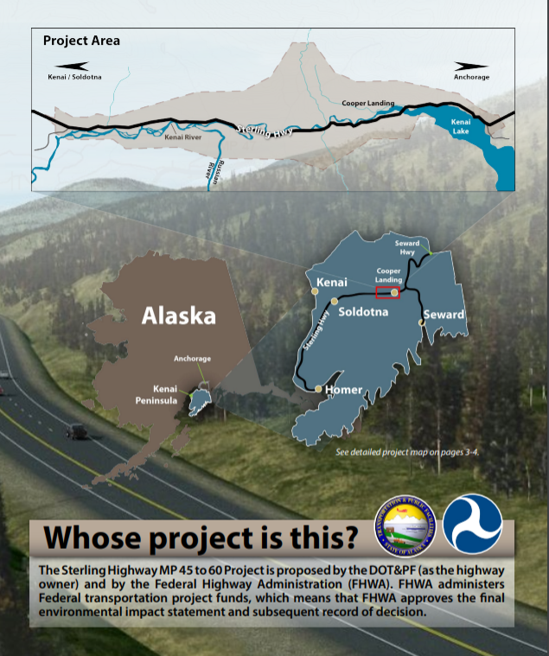
Owning the decision
DOT&PF and FHWA

Slide 13
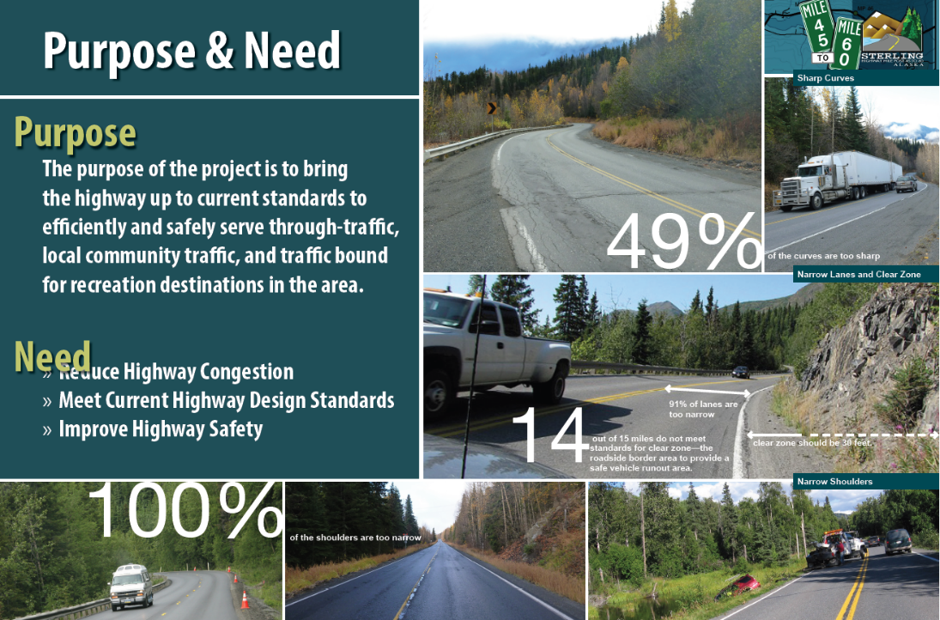
Notes:
Need for improvement was universally agreed upon.
Good good good

Slide 14

Stakeholders
Diversity
US Forest Service; Alaska Fish & Game; US Fish & Wildlife Service; SHPO
Government
Kenaitze & CIRI
Cooper Landing residents
River users
So many more…
Notes:
Tribes
Section 4(f)
ANILCA Title XI – due to Resurrection Trail
Recreational users

Slide 15
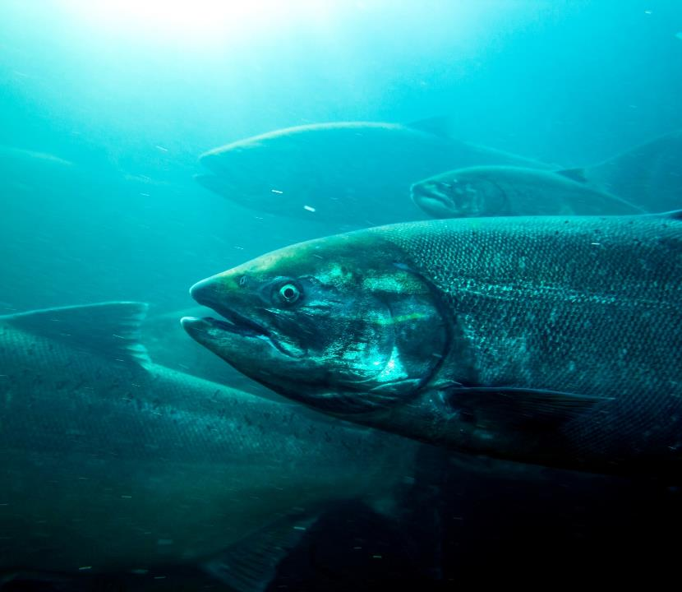
Issues in Play
Fish fish fish!
Wildlife
Wilderness
Community & business impacts
Cultural & historic resources
Land ownership
Geotech/slopes
Notes:
Fish is the heart of everything
Heavy wildlife use
Wilderness with a capital “W” on the west end = congressional approval to build
Fear of lost revenue in the community
Rich cultural and historic use
Land ownership – CIRI lands, USFS, USFWS, private owners, KPB, state and local selected parcels identified for future development
Steep area, river, etc

Slide 16
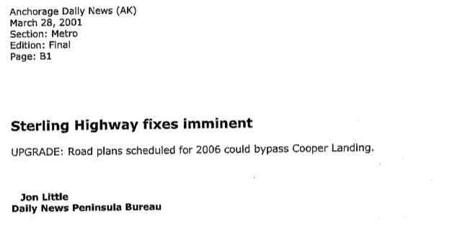

Slide 17
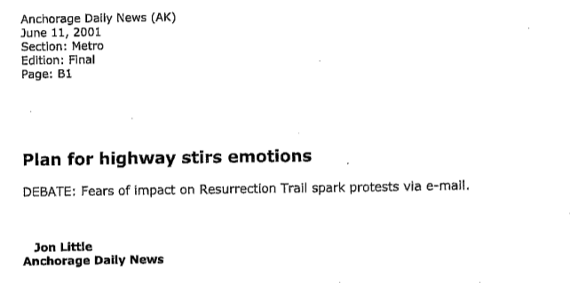

Slide 18
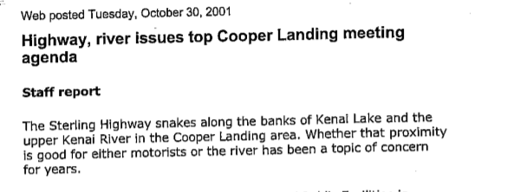

Slide 19
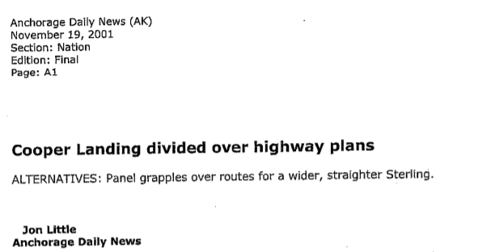

Slide 20
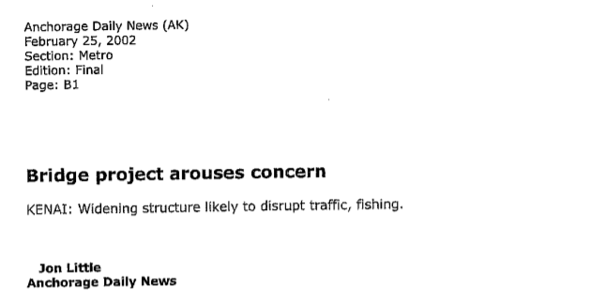

Slide 21
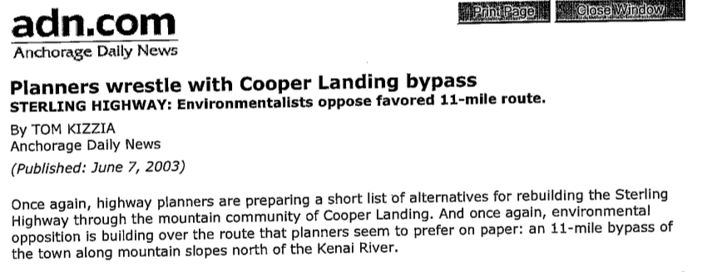

Slide 22
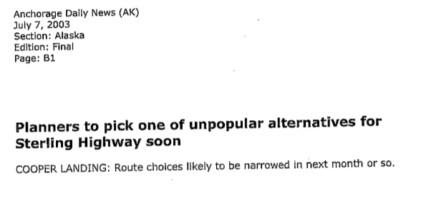

Slide 23
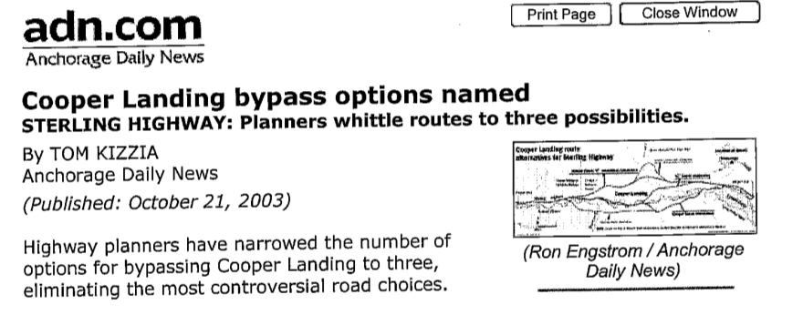

Slide 24
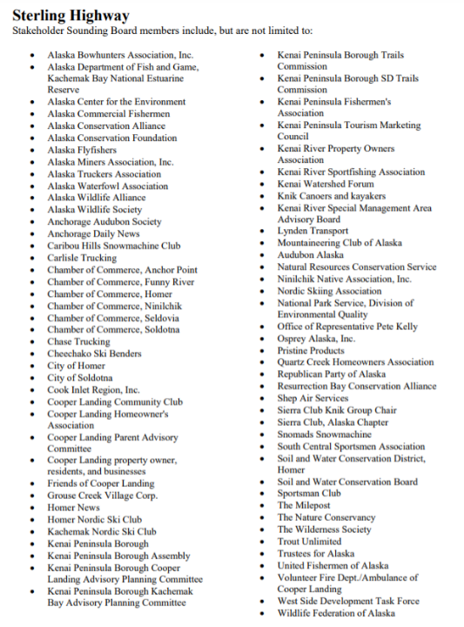
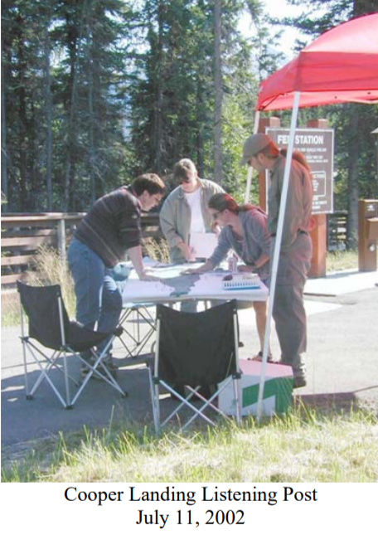
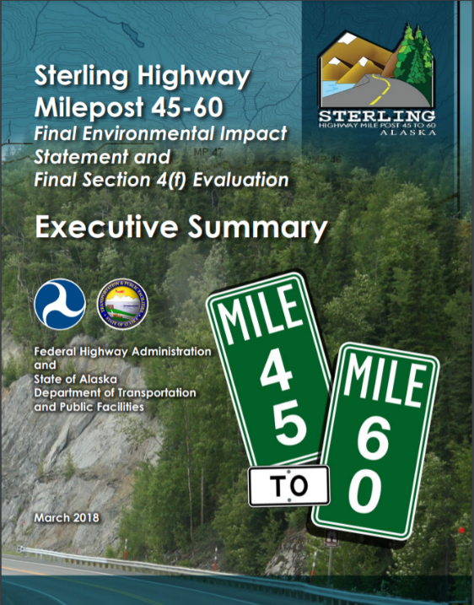
Outreach Techniques
Stakeholder Sounding Board
Listening Posts
Surveys/interviews
Facilitated agency meetings
Executive Summary
Multimedia
Notes:
Survey – river based vs highway based; how traffic is actually accessing businesses
Ongoing agency meetings
Exec Summary & DVDs to publicize and distill info
Multimedia to share ideas

Slide 25
Why is it taking so long?
ANILCA Title XI
ANILCA 810 Subsistence
Russian River Lands Act
NEPA
Section 4(f)
Did you see that issues list?
Did you see that stakeholder list?

Slide 26
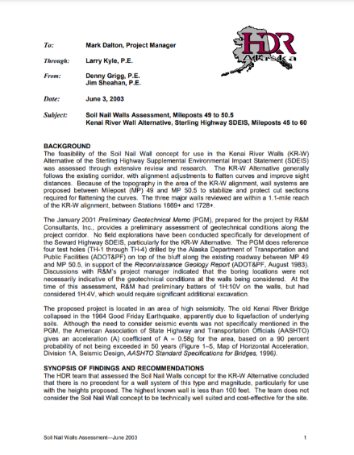
Why can’t you just improve it in place?
2003 study
Peer reviewed
Researched
Public didn’t “get it”
Notes:
Great story about technical vs public info

Slide 27
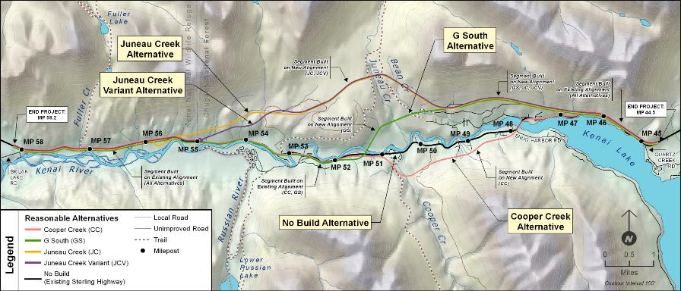
Why can’t you just improve it in place?
Unfeasible Alternative
This section is not feasible
Why not rebuild the entire alignment?
It has unstable soil, high walls, and is close to the river
Notes:
Engineers did try to develop an alternative that stayed on the existing alignment the whole way.
In this section it is not technically feasible to rebuild the highway to meet current standards.
The area has unstable soil, and would require large cuts and high walls. Because of the poor soils, high walls, and proximity to the river, engineers determined that the risk was too great.

Slide 28
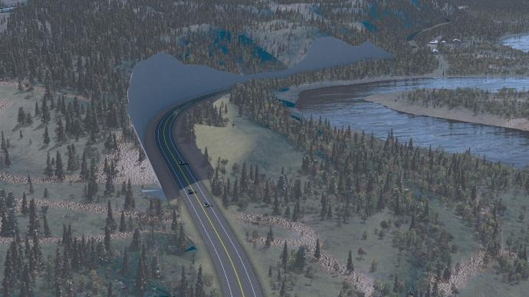
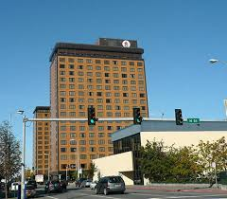
Why can’t you just improve it in place?
Unfeasible Alternative
Unstable soil
If these wall fail, they spill into or dam the river…
Close to the river
…or block the highway
High Walls ~ 160 to 200 feet high
That is as high as an 18 story building
Notes:
This rendering shows the best option that the engineers were able to develop.
The cuts in this area were between 160 and 180 feet high, and could be as high as 200 feet.
That is as tall as an 18 story building. The height of these walls was deemed in feasible and because of the poor soils, the risk of failure was too high for them to be safe.
Because the cuts would be so close to the river, a landslide would deposit material into the river and would block the highway.
Because of the sensitivity and importance of the river such risks are unnacceptable.
Moreover, closing this stretch of highway to commerce would create economic impacts and because of the safety to the traveling public, routing was rejects.

Slide 29
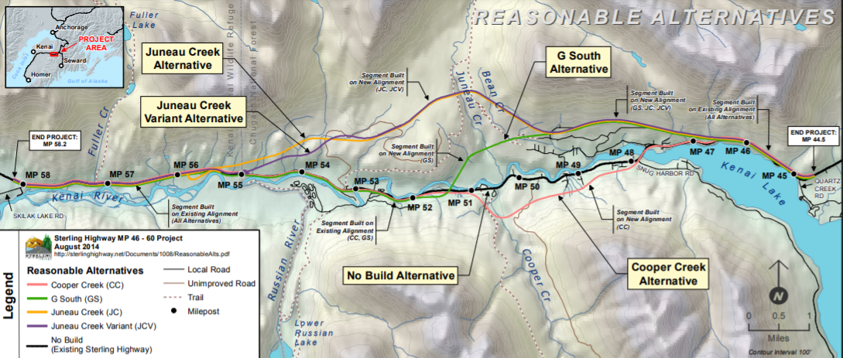
Alternatives
Notes:
Reasonable alternatives
Really a lot of study and technical work behind the scenes
Wetlands
Wildlife studies
106 discussions

Slide 30
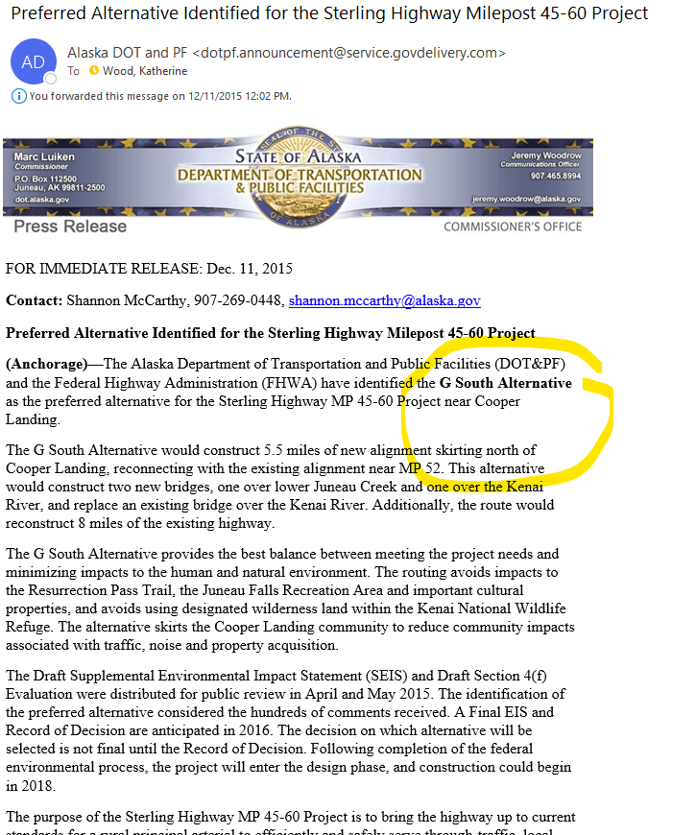
The Right Choice
Draft EIS – no recommendation
G South selected
Notes:
Political will to advance – FHWA new administrator motivated to FINISH
DOT&PF saw this as a compromise
JNU Creek performed the best, but large agency opposition
Cooper Creek not like by community

Slide 31
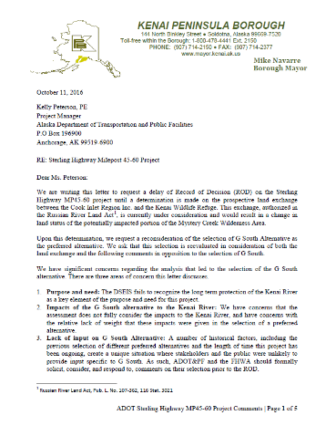
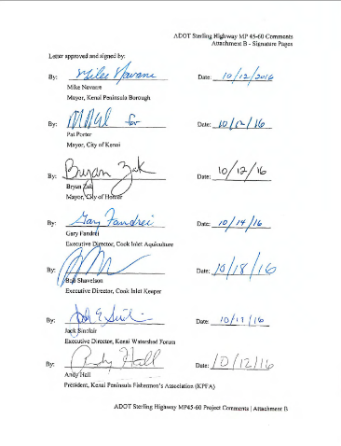
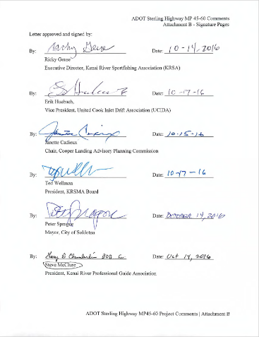
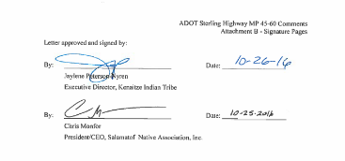
The Letter
Notes:
Doesn’t best meet your P&N
Relative weight of the Kenai River impacts not adequately considered

Slide 32
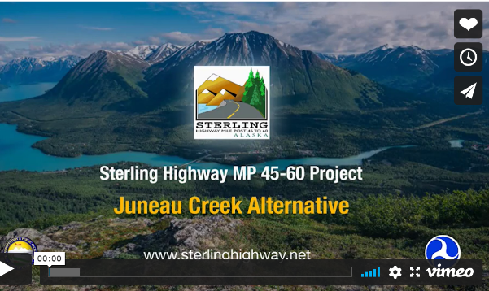
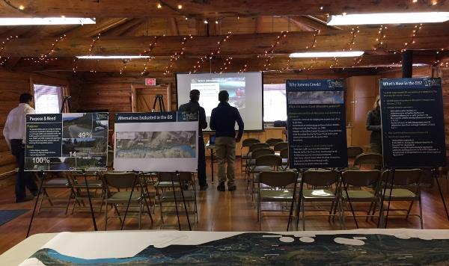
The Right Choice, round 2
Juneau Creek Alternative
No litigation

Slide 33
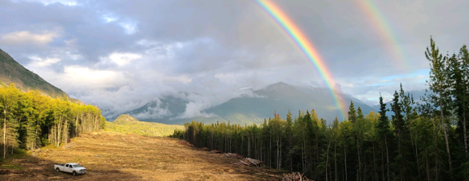
Design / Construction Phase

Slide 34
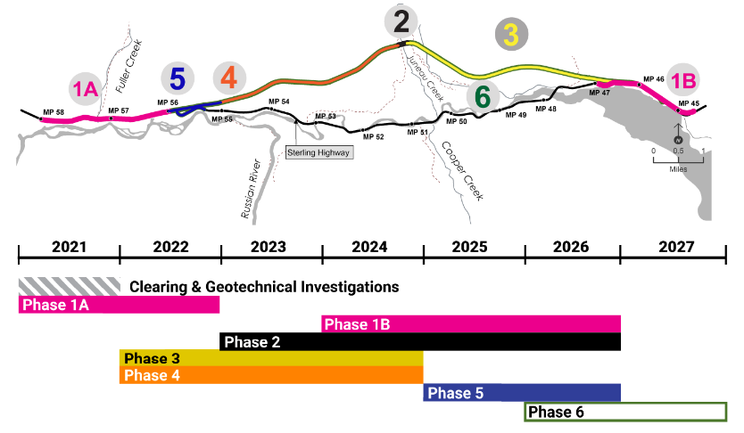
Complexities
Many decisions have been made
Phased design & construction
Land exchange still not complete
New stakeholders (Rip VanWinkles)
Multiple parties
CMGC
Notes:
Can’t go back on the EIS commitments – don’t start it over!
Large project – phased

Slide 35
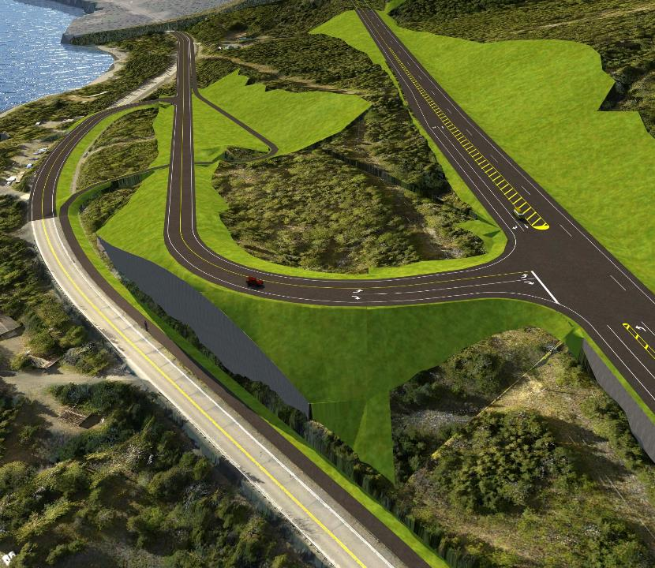
Techniques
Single point of contact
Clearly define the sideboards
Visualizations
Coordination
Consistency
Notes:
Ali talked about the boundaries

Slide 36
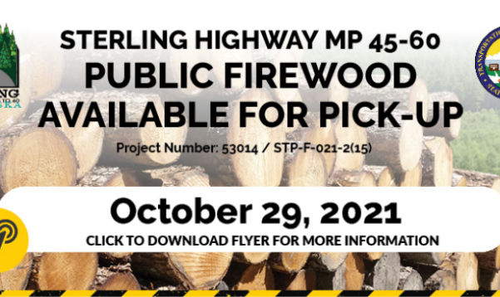
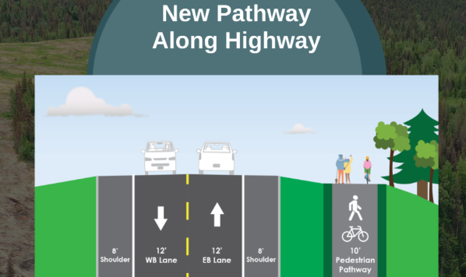
Design Changes
so far
Public firewood
Pathway along new alignment
Pedestrian connections
Notes:
From the public perspective – these are the good things so far in the design phase

Slide 37
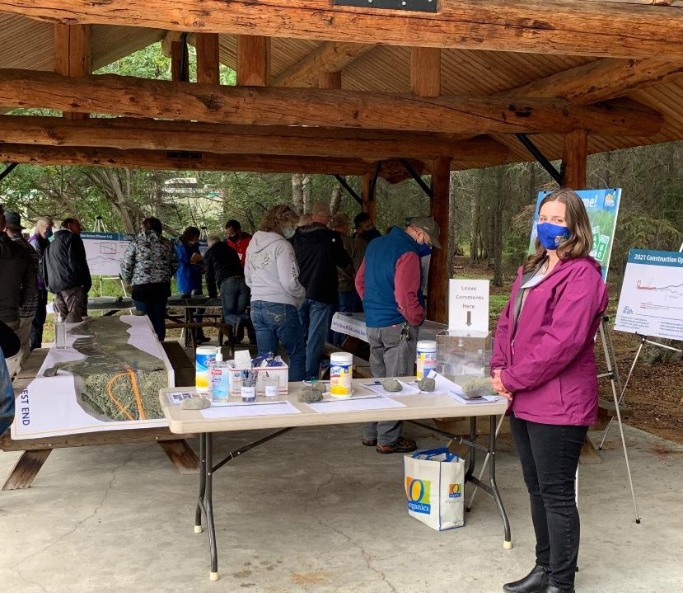
Oh no COVID!
Online meetings
  Prezi
  Webex
Chatbot
Pre-recorded video
Outside meeting
Facemasks

Slide 38
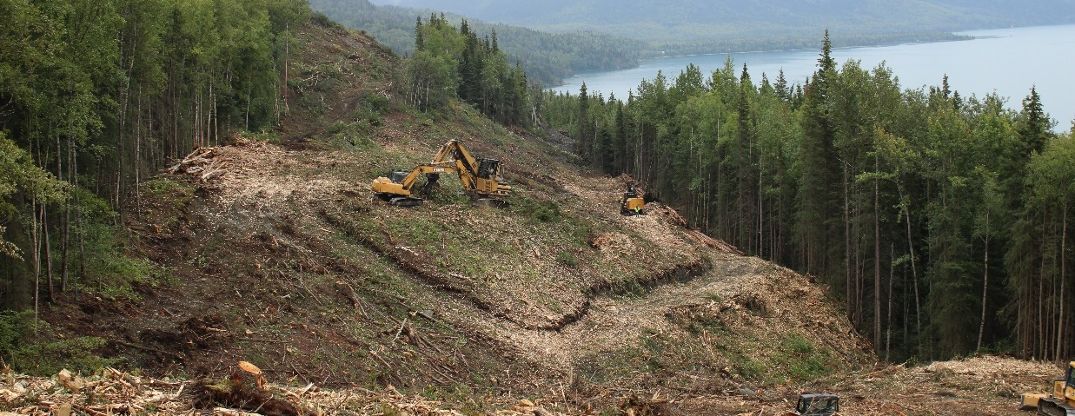
Takeaways

Slide 39
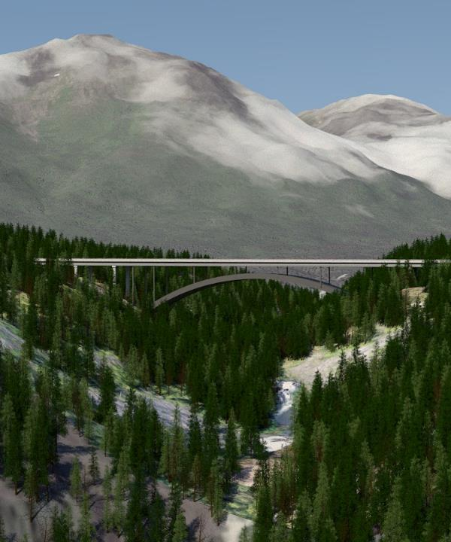
What I learned…
… it’s getting better all the time
Give context
Tell the story
Find the common ground
Flex
Show empathy

